Slide 1
Deep Learning

Slide 2
Preface
While the existing traditional machine learning algorithms are powerful, versatile in many domains,
they often require structured or labeled training data, which can be tedious for developers and users
to extract the features manually for large-scale and complex models.
On the other hand, deep learning make use of artificial neural networks with multiple layers to
automatically extract high-level features from raw data, reducing the need for human intervention
and making it well-suited for complicated tasks that comes with large datasets.
In this chapter, you will learn about how a deep learning model works under the hood, understand the pros
and cons of different neural networks, and implement these models using Keras and TensorFlow.

Slide 3
Artificial Neural Network
Artificial Neural Network have several aliases, such as Neural Network, Neural Net, ANN, or NN.
In biological neural network, neurons communicate through synapses by sending electrical signal.
In NN, neurons are simulated using mathematical functions called “artificial neurons” and are
connected for signal transportation based on the functions’ inputs and outputs.
After being “activated” by other neurons, a neuron will propagates the result to the neighboring
neurons, this is the fundamental concept of how a NN learns and evolves from mistakes effectively.

Slide 4
Layer and Neuron
A NN is composed of three layers:
Input Layer: accept input data
Hidden Layer: the layer where computation take place
Output Layer: output predicted label or probability
A layer is made of nodes, they might connect to one or more nodes in other layers.
The input of a single node consists the results that comes from the other nodes, each of
which is multiplied by a weight to form a weighted sum.
If there is an activation function, the linear combination from input is passed through it to
generate a non-linear outcome. Otherwise, it just output the result like a linear regression unit do.

Slide 5
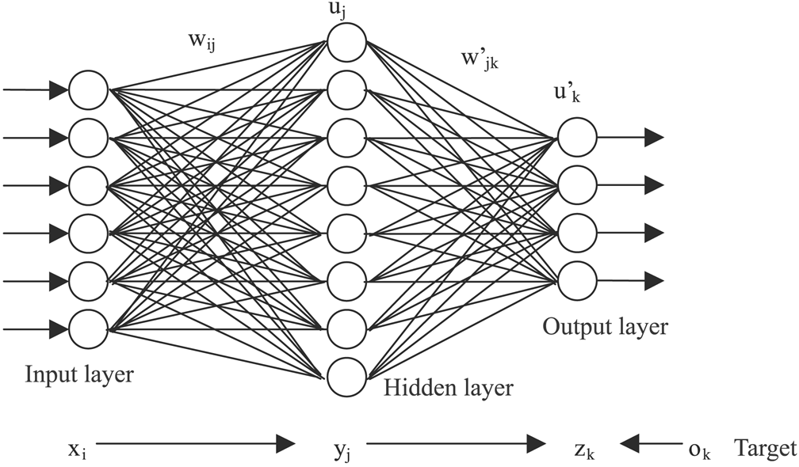
Layer
The figure below illustrates the architecture of a Feed-Forward Neural Network.
https://math.stackexchange.com/tags/neural-networks/info

Slide 6
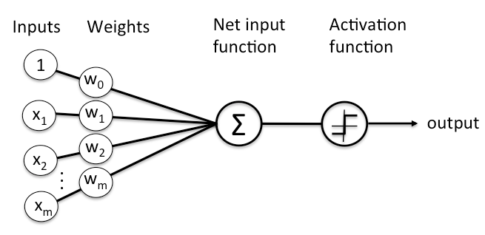
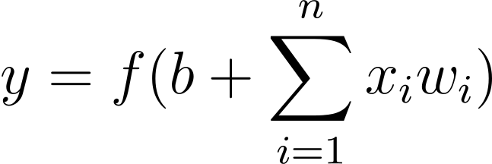
Neuron
A single neuron is also regarded as a “Perceptron”, an early type of NN for binary classification.
https://wiki.pathmind.com/neural-network#define

Slide 7
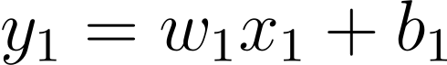
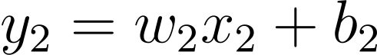
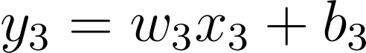
Activation Function
What happened when we remove the activation function from a NN?
In this case, neurons becomes linear functions, transforming the NN’s final outcome
into a composition of linear functions, that is, a linear combination of weight and data.
Therefore, no matter how much neurons are added. this NN will always have the
same effect as using a single layers with a single linear function.
https://towardsdatascience.com/the-importance-and-reasoning-behind-activation-functions-4dc00e74db41

Slide 8
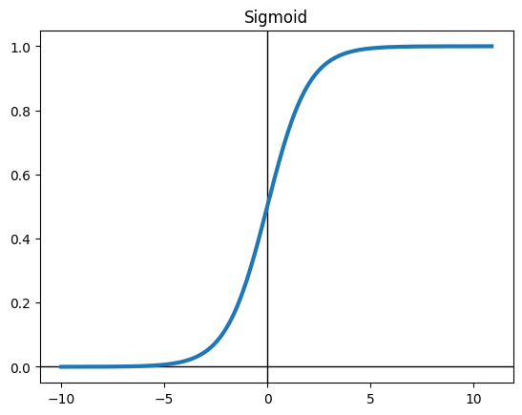
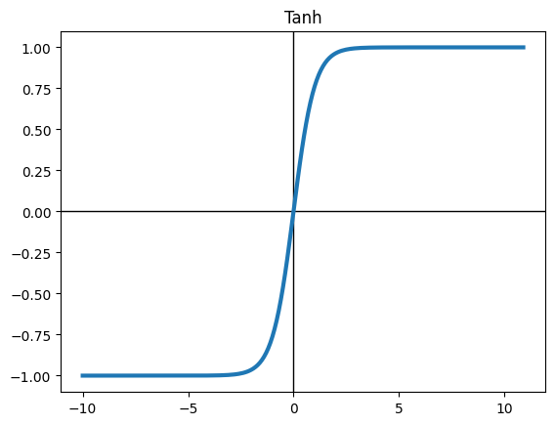
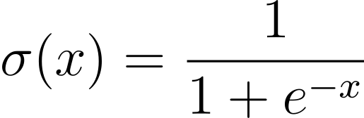
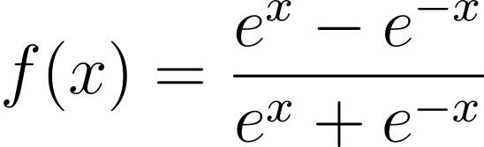
Activation Function
To avoid the problem, a non-linear activation function must be added, e.g., Sigmoid and Tanh.

Slide 9
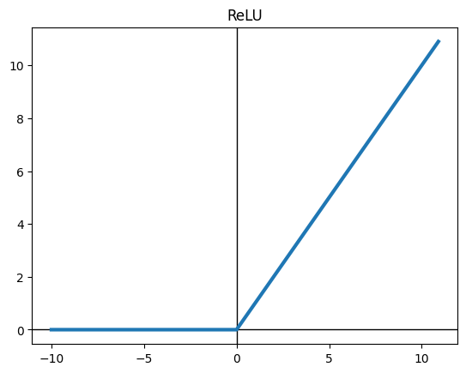
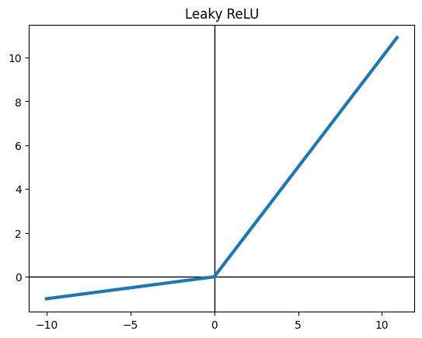
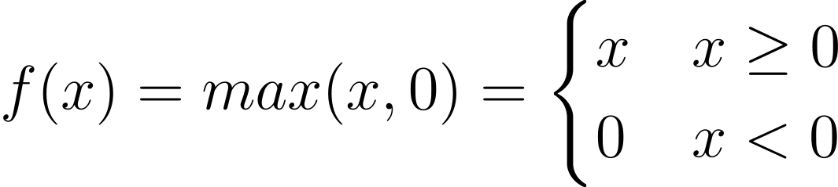
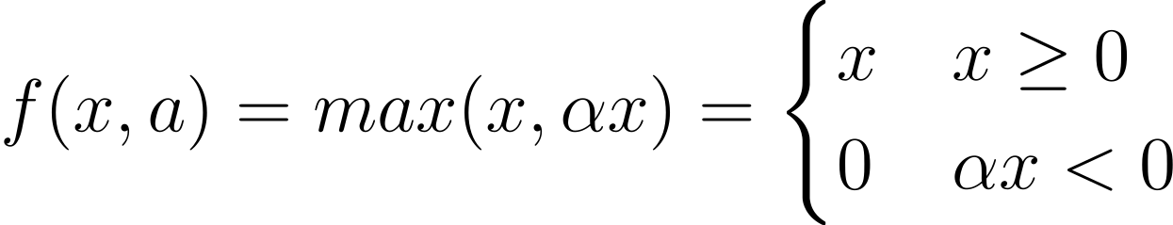
Activation Function
Another activation function, ReLU, stands for “rectified linear unit”, which is actually a variation of the max function.

Slide 10
Gradient Descent and Back Propagation
To find the optimal set of weight and biases for our NN, we utilize Gradient Descent to update each
neuron by calculating the gradient and multiplying it by the learning rate, which is time consuming.
Back Propagation takes advantage of chain rule from differentiation to accelerate the calculation.
In brief, it takes the loss value calculated in the forward pass, then feed it backward through the NN
to adjust the weights.
See here for the back propagation’s animation by 3Blue1Brown on youtube.

Slide 11
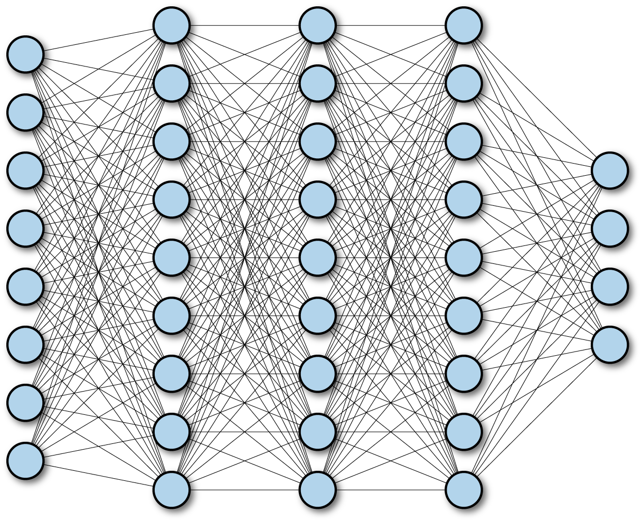
Fully Connected Neural Network (FCNN)
The first NN we will discuss is the Fully (Densely) Connected Neural Network, a simple and versatile components found in different types of NNs.
Consists of one or more fully connected layers
Every neuron in one layer are connected to every neuron of next layer
Number of links between layers with m and n neurons: m * n
A FCNN with multiple layers is simply referred as a “deep” FCNN
A multilayer deep FCNN
https://www.oreilly.com/library/view/tensorflow-for-deep/9781491980446/ch04.html

Slide 12
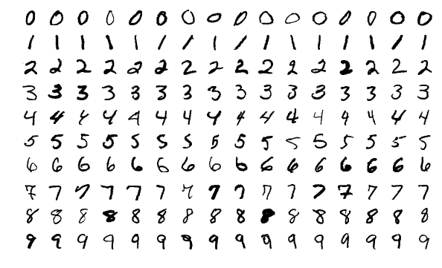
MNIST
Instead of creating training data by ourselves, we use an existing dataset
to better evaluate the model’s performance in real world scenarios.
MNIST: Modified National Institute of Standards and Technology database
Collection of handwritten digits, each of them is a 28 * 28 grayscale image
Commonly used for image processing or classification
60000 training images and 10000 testing images
MNIST Dataset
https://en.wikipedia.org/wiki/MNIST_database

Slide 13
Training, Validation and Testing Set
Typically, we split a data set into training and testing sets, and sometimes a validation set is included.
1. Training Set
Used to fit the parameters in a NN during the training phase.
Takes up most of the input data
2. Validation Set
Used for tuning the model’s hyper-parameters
3. Testing Set
After training and tuning the model, we use the testing set to access
its performance when it encounters unseen real world data

Slide 14
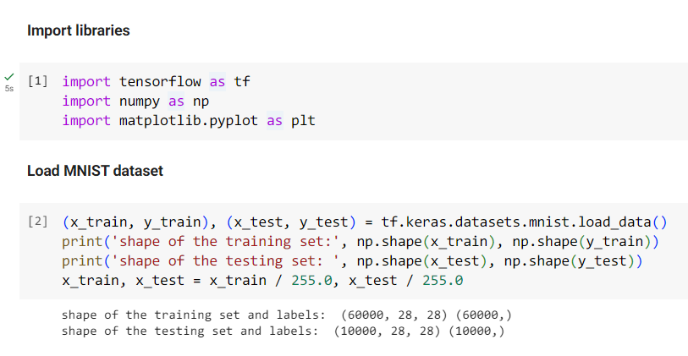
FCNN: Load Data
We load the MNIST dataset using mnist.load_data()
from TensorFlow’s keras.datasets submodule.
By default, it returns two tuples as training and testing set. both
of them consists of data (x) and corresponding labels (y).
The shape of data can be inspected by calling np.shape() on it.
The data is normalized by ourselves, as usual.

Slide 15
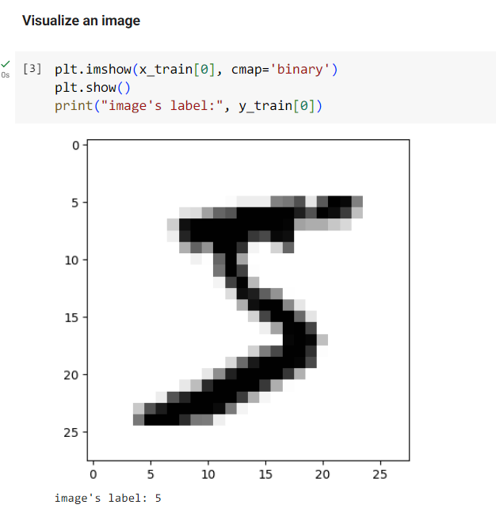
FCNN: Show Image
Each sample is represented as a 28 x 28 floating point
matrix, we can pass it into plt.imshow() to plot the image.
The argument cmap indicates how floating numbers are
mapped to colors, the option “binary” is used to plot a
monochrome image.
We can obtain the image’s label from “y_train” using the
same index.

Slide 16
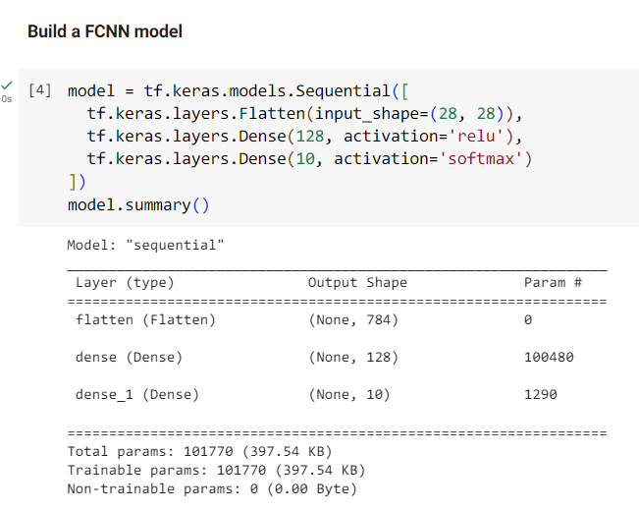
FCNN: Model Construction
Since each layer has only one input and one output tensor,
we can build our NN layer by layer using sequential model
architecture.
First, we have a flatten layer as the input layer, which will
convert the data from n-dimensional to 1-dimensional.
Next, the hidden layer will be a fully (densely) connected
layer with 128 neurons and ReLU as the activation function.

Slide 17
FCNN: Model Construction
Since the images are going to be classified into ten different
classes (0 ~ 9), we prepare 10 neurons in final layer that
output a value for each class of image.
In addition, we apply softmax to normalize the output into
probabilities to make the training more stable and efficient.
model.summary() allows you to view the model’s summary.

Slide 18
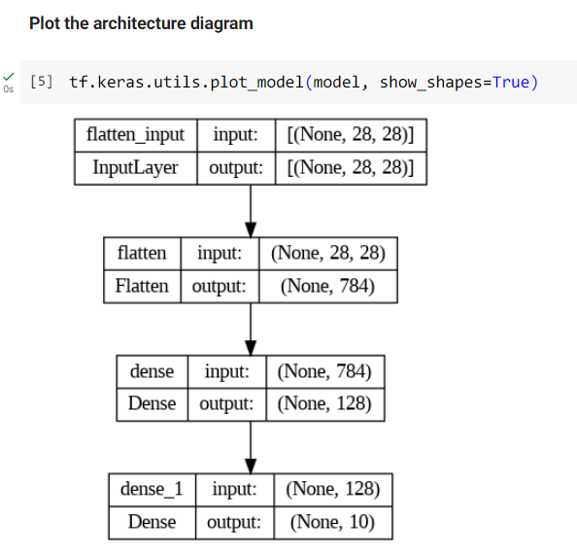
FCNN: Model Visualization
Alternatively, you can use the plot_model() from keras to
plot the model’s architecture as an image.
This is helpful when we want to get familiar with a NN in a
short time without digging the code.

Slide 19
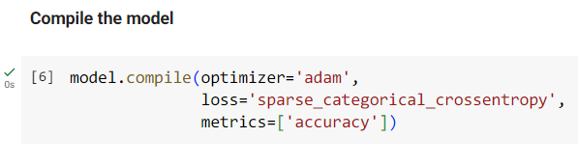
FCNN: Compile Model
We use the Adam (adaptive moment estimator) as our optimizer.
SparseCategoricalCrossentropy loss function is chosen because the data are not one-hot encoded.
We include an accuracy metric to see how it progresses during the training.
The loss value will be recorded automatically.

Slide 20
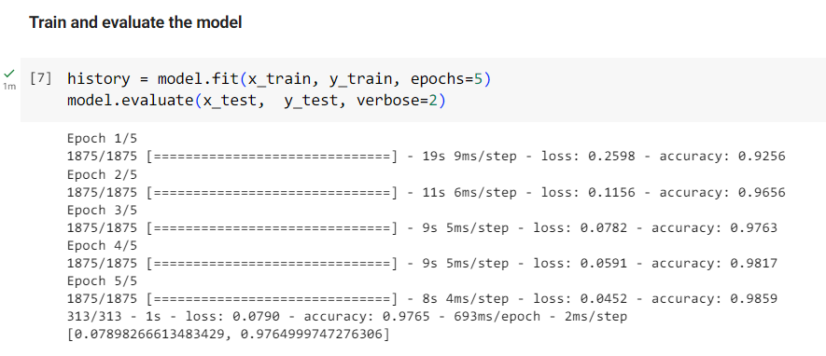
FCNN: Model Training
Set the number of epochs to 5 to train the model on the entire dataset five times.
The default batch size is 32, so the iteration count in each epoch is 60000 / 32 = 1875.
Finally, we can use model.evaluate() with the remaining testing data to assess the model’s performance.

Slide 21
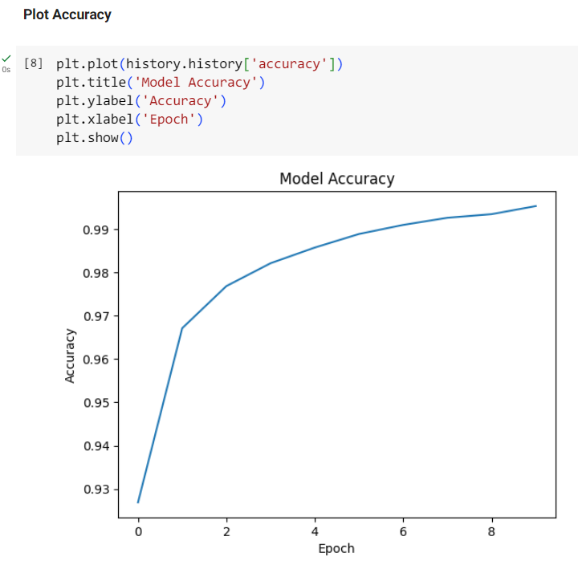
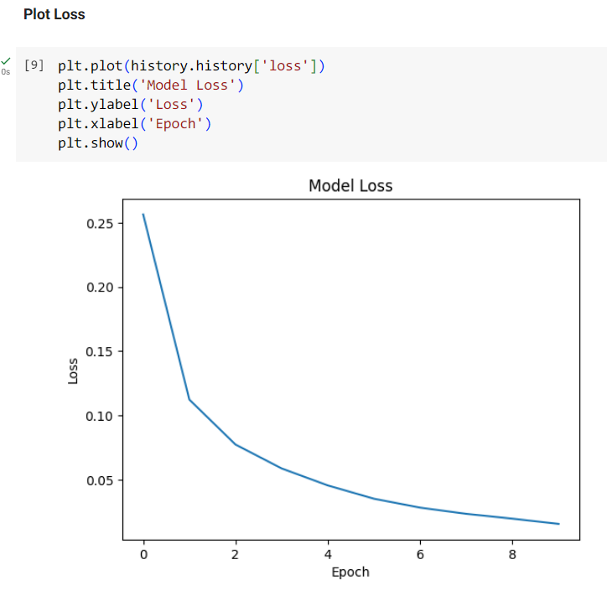
FCNN: Result
The changes in accuracy and loss with respect to epochs are stored in the “history.history”
dictionary, which is the result returned from the model.fit() function.

Slide 22
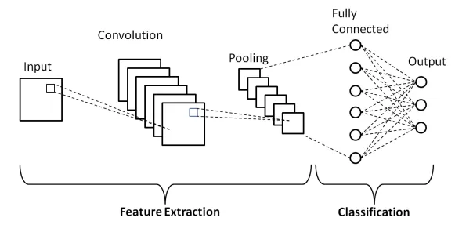
Convolutional Neural Network
1. Convolutional Layer
Extract the local features from the input images
2. Pooling Layer
Reduce the dimension of the feature maps
3. Fully Connected Layer
Predict the class based on the features that have been
extracted and selected by the previous layers
https://medium.com/techiepedia/binary-image-classifier-cnn-using-tensorflow-a3f5d6746697

Slide 23
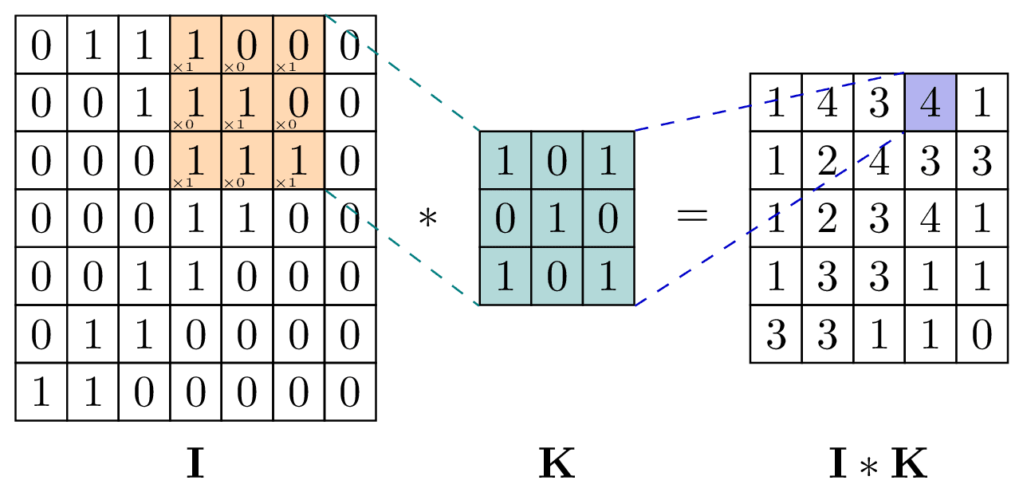
Convolutional Layer
In this layer, we perform convolution on the image using an filter, which is called a “kernel” in 2D convolution.
The filter slides over the input image, and the result is obtained by summing the element-wise products.
The weights of the filters are trained by backpropagation
Slide length: the number of pixels that a filter moves per step
Feature map: the result generated by a convolution layer
The definition of a convolution between input image g and filter h:
Convolution operation
https://medium.com/techiepedia/binary-image-classifier-cnn-using-tensorflow-a3f5d6746697

Slide 24
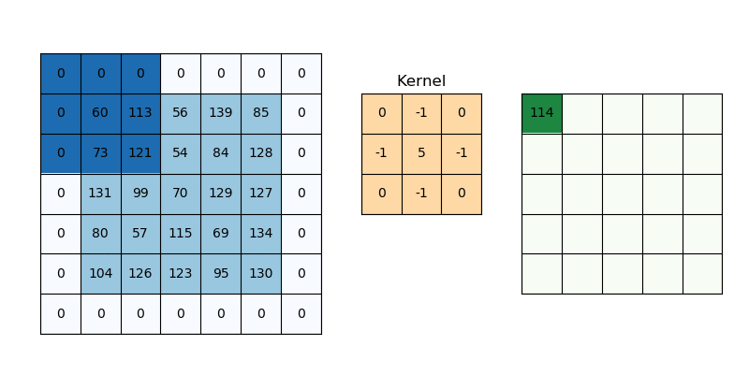
Zero Padding
Since the size of image will be resized after the convolution is performed, a pre-processing is required to prevent it from shrinking
Zero padding: Adding zeros to the image’s border
Reduce border effect
Avoid loosing information at the boundaries
Increase model accuracy
Convolution operation
https://medium.com/@draj0718/zero-padding-in-convolutional-neural-networks-bf1410438e99

Slide 25
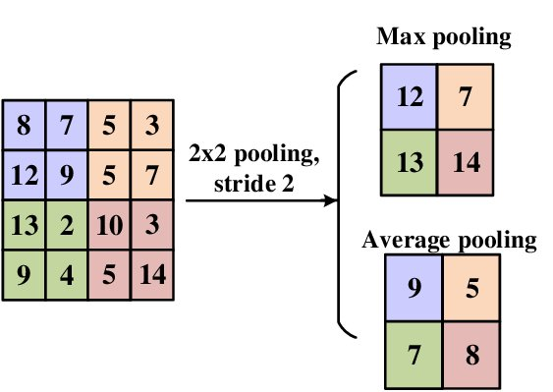
Pooling Layer
The role of pooling layer is to reduce the size of feature map while preserving essential information.
1. Max Pooling
Select the maximum value from the sub-image
2. Average Pooling
Calculate the average of the sub-image as output
By downscaling the feature map, we can reduce the computational cost
during training and reduce the chance of overfitting.
https://www.researchgate.net/publication/340812216_Deep_Neural_Networks_on_Chip_-_A_Survey/figures?lo=1

Slide 26
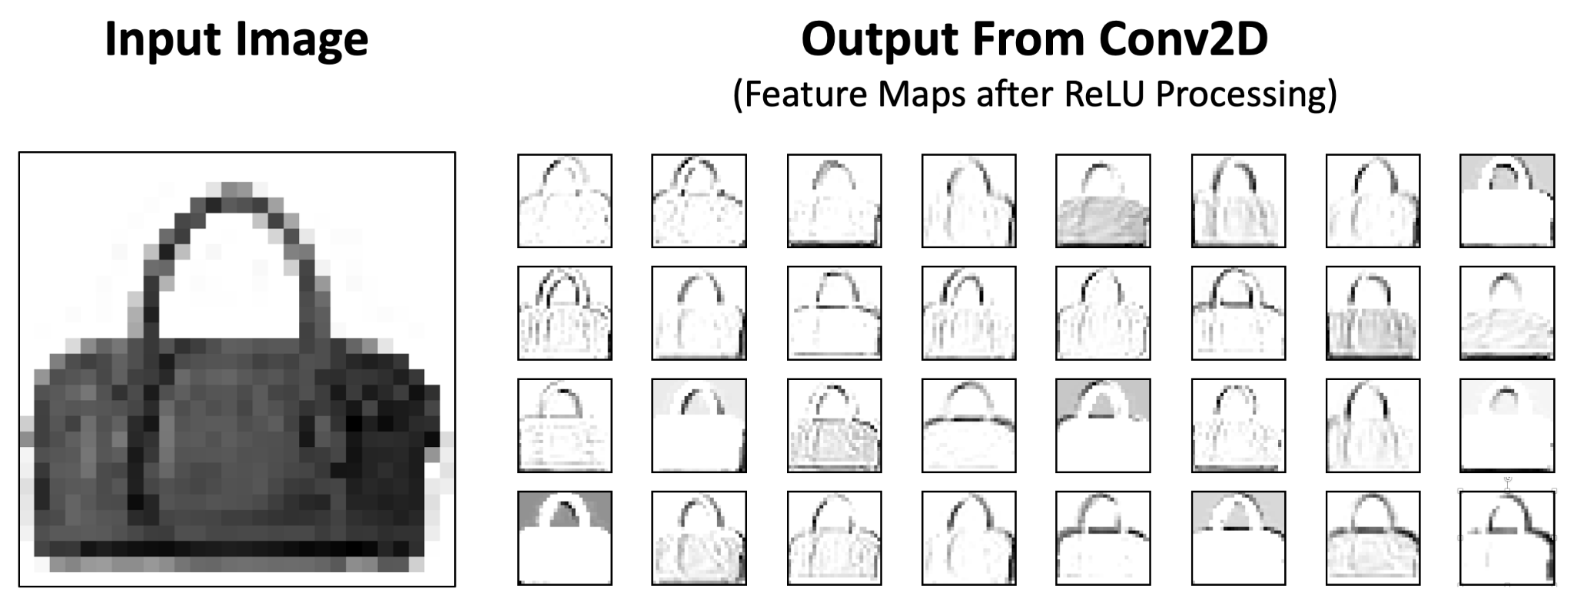
Fully Connected Layer
As the final component, the fully connected layer receives the feature map from interleaved convolutional
and pooling layers, and take advantage of these specific features to enhance the accuracy of classification.
A bag’s feature maps generated from a 2D convolutional layer
https://www.bouvet.no/bouvet-deler/understanding-convolutional-neural-networks-part-2

Slide 27
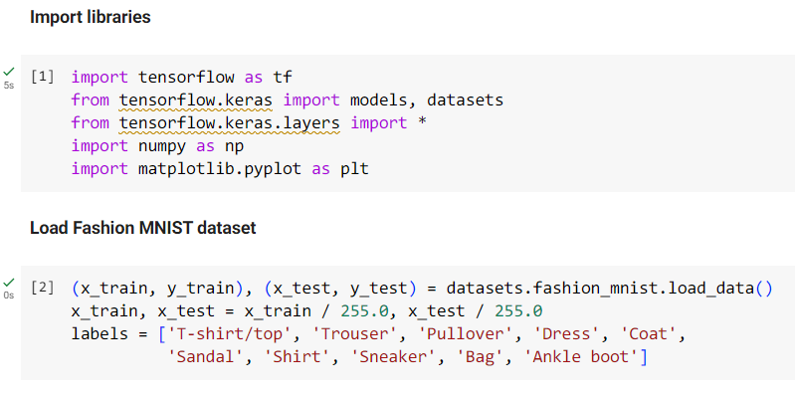
CNN: Load Data
This time, we use Fashion MNIST as the dataset, a MNIST-like dataset consisting of fashion images.
The labels for fashion images are stored as integers, so we need to map them into their class names manually.
The names are only used for displaying the images, not for training.
https://www.bouvet.no/bouvet-deler/understanding-convolutional-neural-networks-part-2

Slide 28
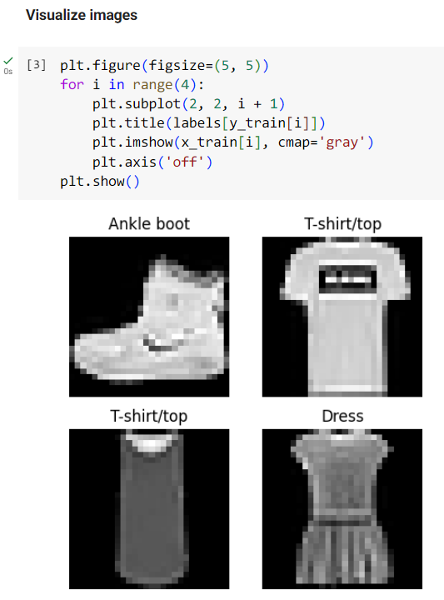
CNN: Show Image
We create a figure with four subplot to showcase the
first four images and their labels.
A subplot is created using plt.subplot(row, column, index),
and the titles can be set using plt.title().
The color mapping argument “gray” is simply the inverse of
“binary” used in the previous section, both of them will
convert the input matrix into a grayscale image.
https://www.bouvet.no/bouvet-deler/understanding-convolutional-neural-networks-part-2

Slide 29
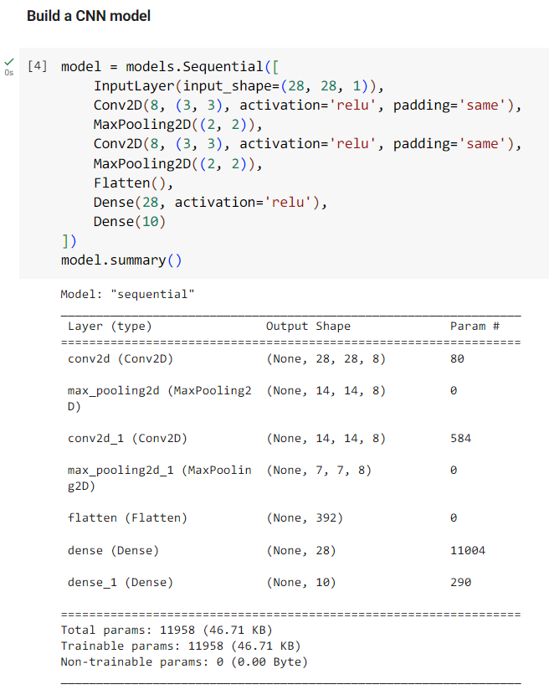
CNN: Model Construction
The shape of a single data must be specified in the input layer,
which is a 28 * 28 single channel image.
Each 2D convolutional layer has eight 3 * 3 filters and a ReLU
function as the activation function.
The “padding” option is set to “same” to enable zero padding in a
convolutional layer.

Slide 30
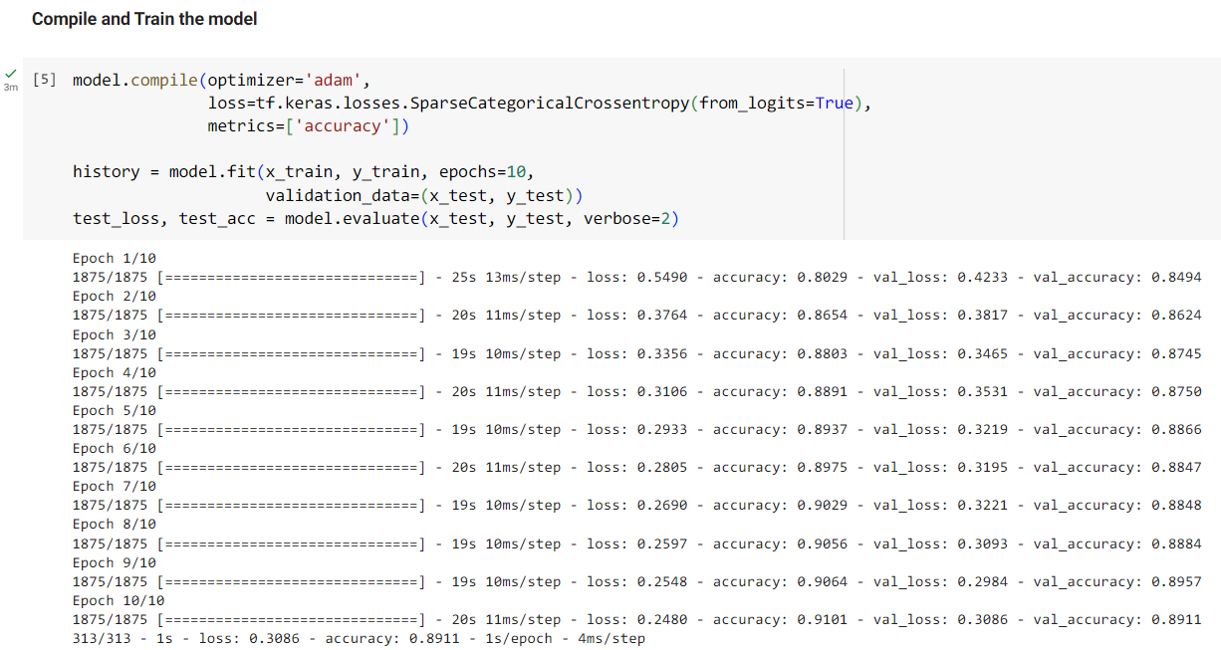
CNN: Compile and Train Model
The testing data is also used as validation data to record the change of loss and accuray during model training.

Slide 31
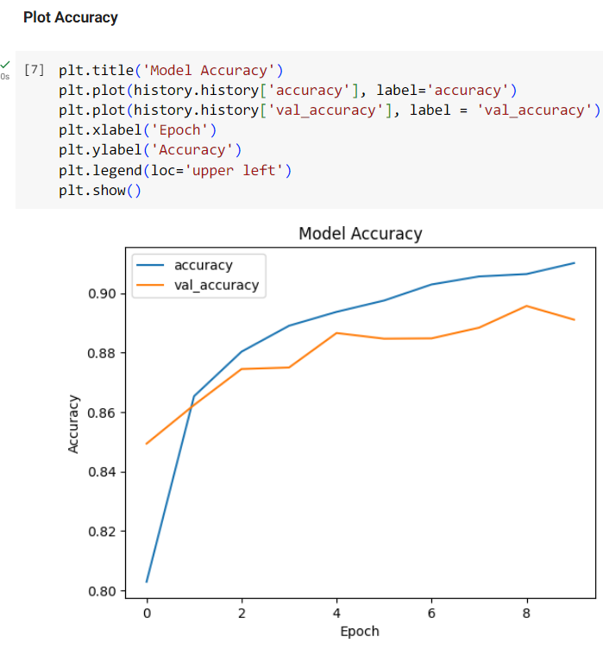
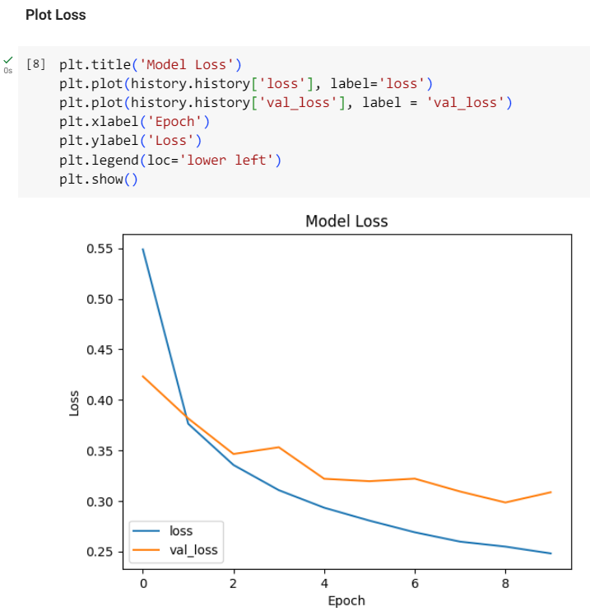
CNN: Result
The validation data is not involved in weight update; it’s used to assess the model’s performance on unseen data.
The validation accuracy fluctuates due to the size of the validation set, the number of epochs, or the batch size.

Slide 32
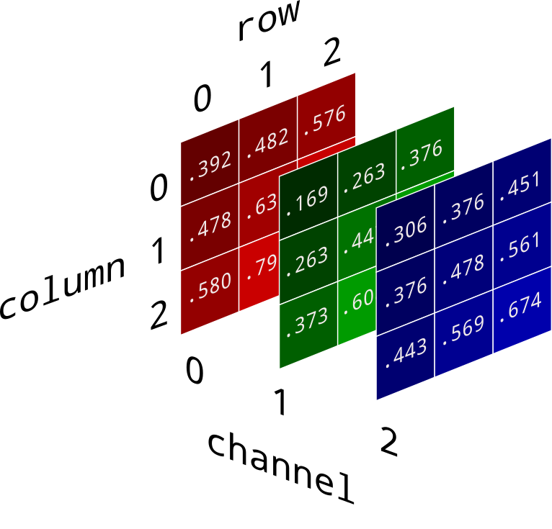
RGB Image Color Channel
1. Grayscale Image
Single channel
Pixel Value ranges from 0 to 255
2. RGB Image
Three channels: red, green, and blue
A single pixel is a 3-tuple: (r, g, b)
Each channel’s value range from 0 to 255
https://e2eml.school/convert_rgb_to_grayscale

Slide 33
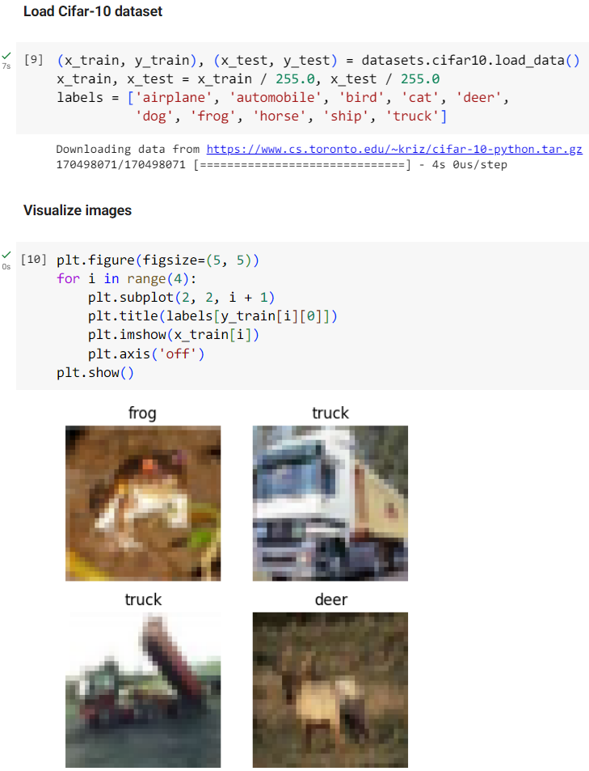
CNN: Load and Visualize Cifar-10 Dataset
We use Cifar-10 dataset to demonstrate how a
CNN model processes RGB images.
The shape of a single image is (32, 32, 3), a 32 * 32
image with three color channels R, G and B.

Slide 34
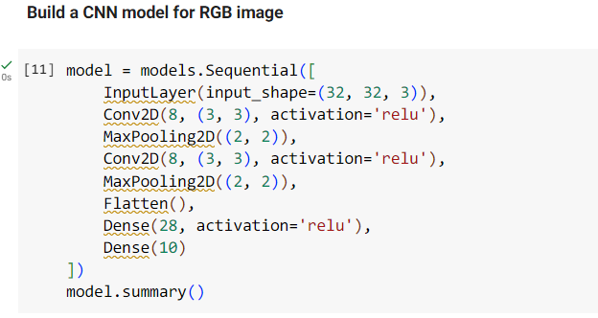
CNN: Model Construction
We use a similar model to see how well it performs with RGB images.
The only difference is the input shape in the input layer.

Slide 35
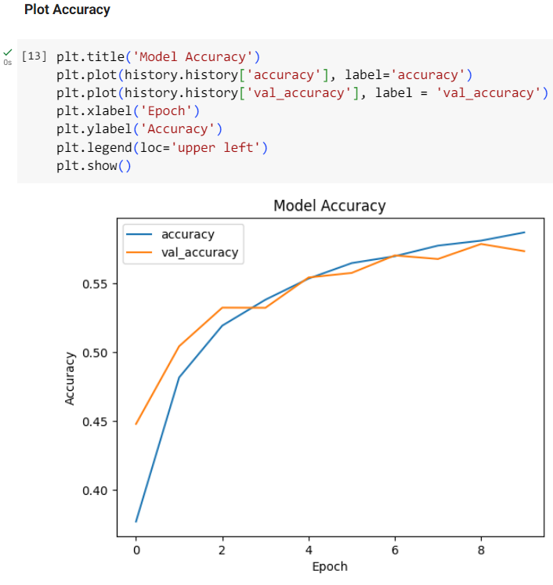
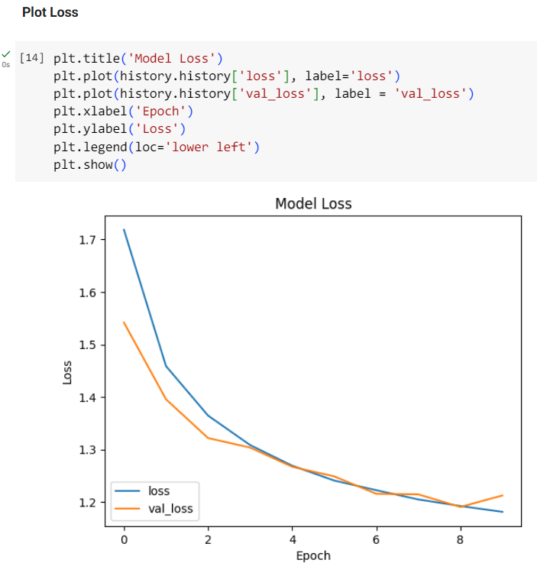
CNN: Result
After compiling and training, we plot the result as usual.
The current model might not be powerful enough to handle complicated RGB images due to its low accuracy, but you can tune the model’s hyperparameter or structure to improve it by yourself.

Slide 36
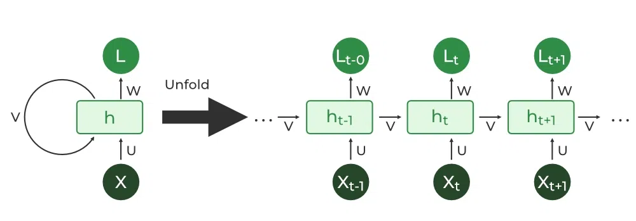
Recurrent Neural Network (RNN)
Used for processing sequential data, such as time series data, text, or genomes
A hidden state will memorize the previous information about a sequence
Both the hidden state and the current state are used to determine the output
The information will cycle through the model over and over again
Unfolding a RNN cell (layer), the subscript t denote the system at time t.
https://www.geeksforgeeks.org/introduction-to-recurrent-neural-network/

Slide 37
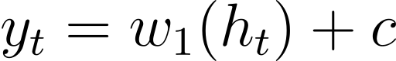
RNN: Hidden State
The hidden state at time t can be calculated by taking the weighted sum of the previous hidden state ht-1 and the current input xt, which is then passed through a Tanh activation function.
After the hidden state is computed, we can simply use the weighted hidden state as the output, or add another activation function to introduce non-linearty between the hidden state and the output.
https://www.geeksforgeeks.org/introduction-to-recurrent-neural-network/

Slide 38
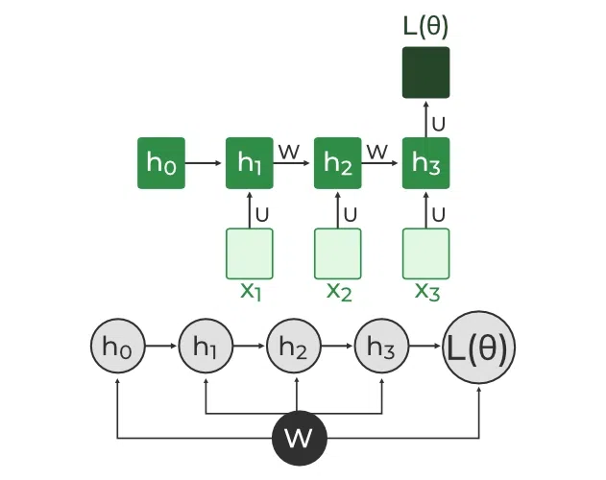
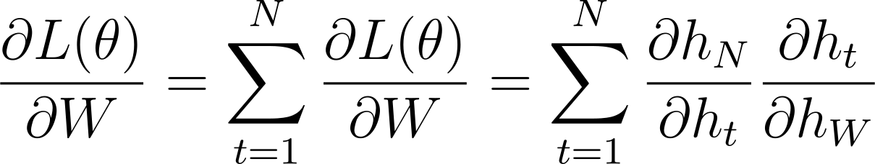
RNN: BackPropagation Through Time (BPTT)
Since both the input data and hidden state are involved in weight update, the backpropagation will be
applied across all the hidden states. This is process is known as Back Propagation Through Time (BRTT).
The gradient of the loss function can be simplified as follows,
and backpropated to update the NN’s weights:
BPTT in RNN
https://www.geeksforgeeks.org/introduction-to-recurrent-neural-network/

Slide 39
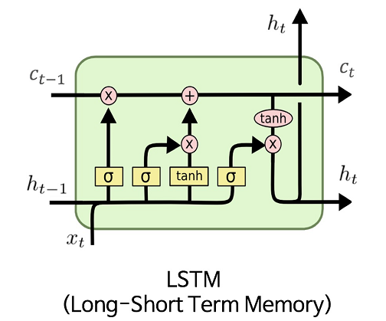
Long Short-Term Memory (LSTM)
Due to its recurrent architecture, RNNs suffer from vanishing and exploding gradients,
which leads to a lack of capability to handle very long sequences. LSTM, a special
version of RNN, is proposed to address the problems mentioned above.
There are three gates in a LSTM unit to control the flow of information:
Input Gate: Quantify the importance of the new information added
Output Gate: Update the cell state based on the output from input gate
Forget Gate: Determine the portion of information to be removed
You can find more details here.
https://commons.wikimedia.org/wiki/File:LSTM.png

Slide 40
IMDB Dataset
To perform sentiment classification, we will use IMDB to benchmark our model.
A dataset of 25000 movie reviews from IMDB
Reviews has been preprocessed into lists of indices based on words’ frequencies
Each review is either labeled as 1 “postive” or 0 “negative”
This movie is fantastic, …
[32, 67, 94, 74, 0, …]
is | 94
fantastic | 76
movie | 67
this | 32

Slide 41
Embedding Layer
In sentiment analysis, we observed that:
Similar words might have similar embedding representations
The relation between word and embedding vector can be one-to-many
Therefore, an embedding layer is added before RNN layer:
The Embedding layer can be understood as a lookup table that maps from integer indices (which stand for specific words) to dense vectors (their embeddings).
The floating values are randomly generated, then updated by backpropagation during training
[32, 67, 94, 74, 0, …]
[[0.3, -0.76, …, xn], [0.31, 0.27, yn], …]

Slide 42
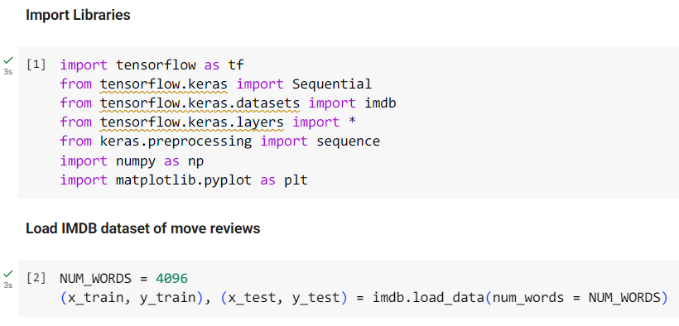
RNN: Load Data
IMDB dataset is also a built-in dataset of Keras, so we can simply load it as usual.
The “num_words” argument indicates the number of the most frequent words retained for mapping.

Slide 43
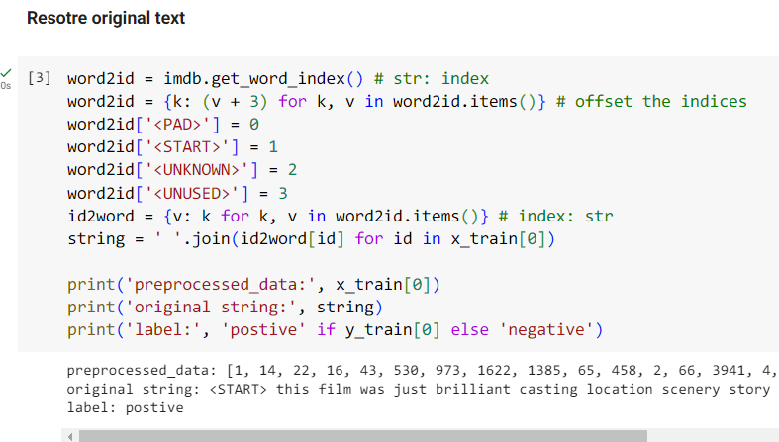
RNN: Inspect Training Data
The method “imdb.get_word_index()” returns the
dataset’s lookup table.
To convert the data back to strings using their
frequencies as indices, the key and value must
be exchanged.
The indices 0 ~ 3 are preserved for special word
like padding or unknown words.

Slide 44
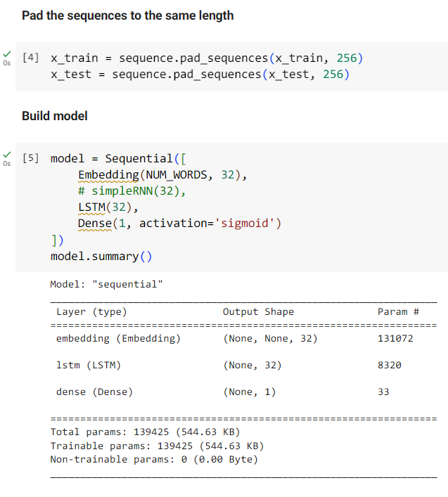
RNN: Model Construction
Since the NN cannot handle data with varying
lengths, they must be trimmed or padded to the
same length.
Using “pad_sequences()”, sequences longer than
256 will be trimmed, otherwise, it will be padded
with zeros until the length is equal to 256.

Slide 45
RNN: Model Construction
Each sequence will be transformed into an embedding
vector of 32 floating values by an embedding layer.
We use an LSTM layer here for better performance,
but you can use a simpleRNN layer instead.
The single neuron in the last FC layer will output the
prediction of either 1 or 0.

Slide 46
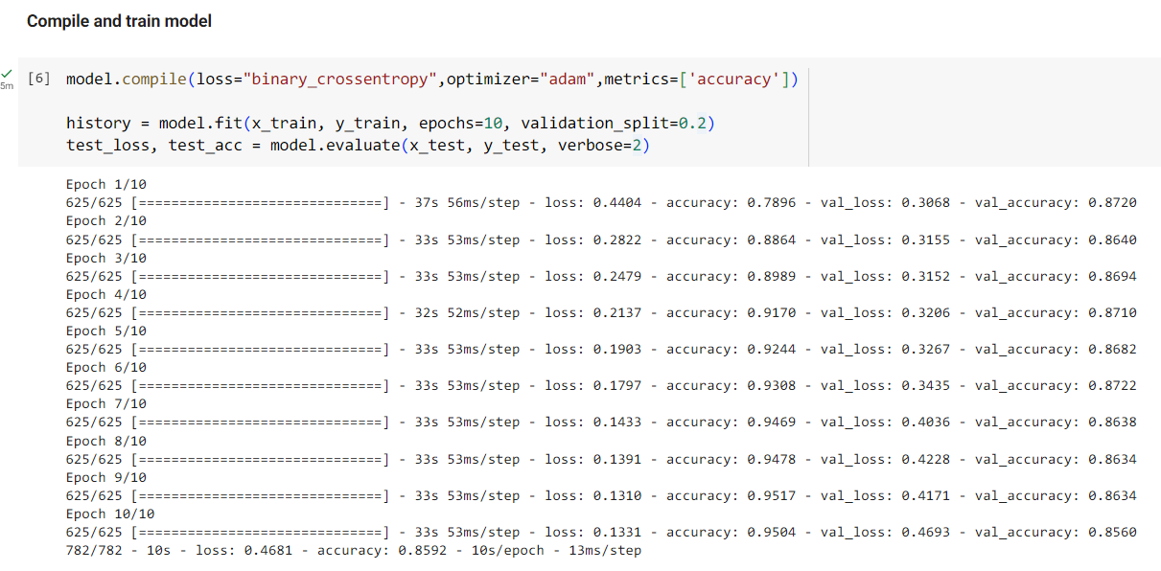
RNN: Compile and Train Model
For binary classification, the binary cross entropy is a suitable choice
Set the validation_split to 0.2 to use 20% of the training data as validation set

Slide 47
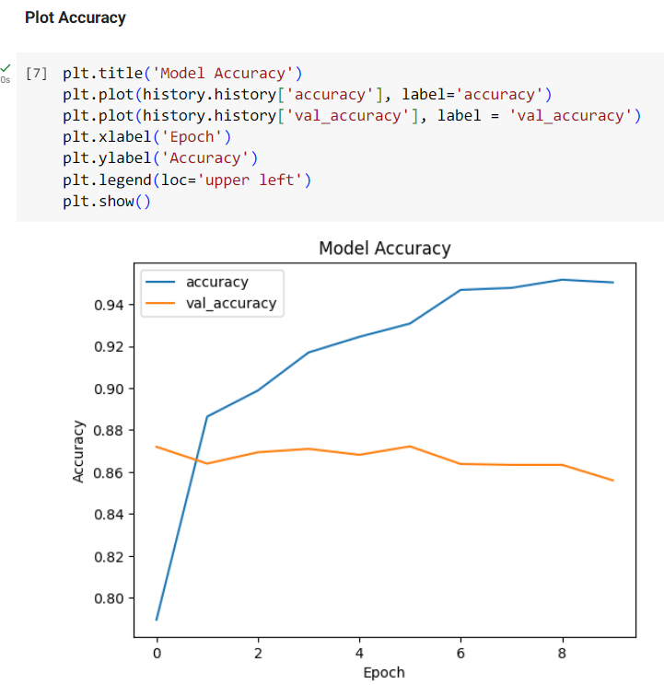

RNN: Result
Since there are only 5000 (25000 * 0.2) sequences in the validation set, the accuracy and loss for it didn’t converge as expected. However, we still get a decent performance out of this simple model.

